Slide 1
Data Mining: Concepts and Techniques — Chapter 2 — Know Your Data

Slide 2
Data Matrix and Dissimilarity Matrix
Data matrix
Object by attribute structure(n x p)
n data points with p dimensions
Two modes
Dissimilarity matrix
Object by object structure(n x n)
n data points, but registers only the distance
A triangular matrix
Single mode

Slide 3
Proximity Measure for Nominal Attributes
Can take 2 or more states, e.g., red, yellow, blue, green (generalization of a binary attribute)
Simple matching
m: # of matches, p: total # of variables

Slide 4
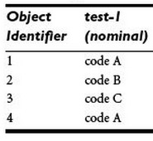
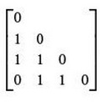
Dissimilarity between Nominal Attributes
Here, we have one nominal attribute, test-1, so p=1.
The dissimilarity matrix is as shown below:

Slide 5
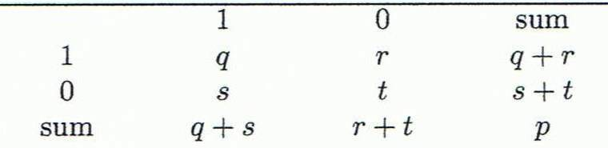
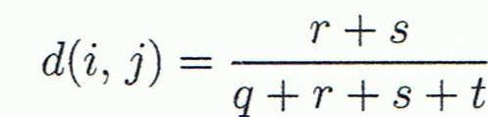
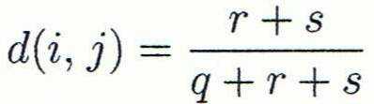

Proximity Measure for Binary Attributes
Object j
A contingency table for binary data
Distance measure for symmetric binary variables:
Distance measure for asymmetric binary variables:
Jaccard coefficient (similarity measure for asymmetric binary variables):
Object i

Slide 6
Dissimilarity between Binary Variables
Example
Gender is a symmetric attribute
The remaining attributes are asymmetric binary
Let the values Y and P be 1, and the value N 0

Slide 7
Distance on Numeric Data: Minkowski Distance
Minkowski distance: A popular distance measure
where i = (x_{i1}, x_{i2}, …, x_{ip}) and j = (x_{j1}, x_{j2}, …, x_{jp}) are two p-dimensional data objects, and h is the order (the distance so defined is also called L-h norm)

Slide 8
Special Cases of Minkowski Distance
h = 1: Manhattan (city block, L₁ norm) distance
E.g., the Hamming distance: the number of bits that are different between two binary vectors
h = 2: (L₂ norm) Euclidean distance
h → ∞. “supremum” (L_{max} norm, L∞ norm) distance.
This is the maximum difference between any component (attribute) of the vectors

Slide 9
Example: Minkowski Distance
Dissimilarity Matrices
Manhattan (L₁)
Euclidean (L₂)
Supremum

Slide 10
Ordinal Variables
An ordinal variable can be discrete or continuous
Order is important, e.g., rank
Can be treated like interval-scaled
replace x_{if} by their rank
map the range of each variable onto [0, 1] by replacing i-th object in the f-th variable by
compute the dissimilarity using methods for interval-scaled variables

Slide 11
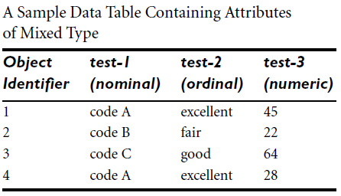
Distance for Ordinal variables
Example: Find dissimilarity matrix for test-2.

Slide 12
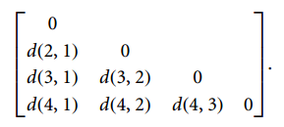
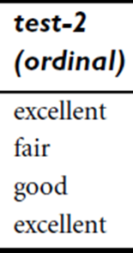

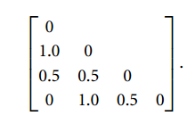
Suppose that we have the sample data shown earlier in Table 2.2, except that this time only the object-identifier and the continuous ordinal attribute, test-2, are available
There are three states for test-2: fair, good, and excellent, that is, Mf = 3. For step 1, if we replace each value for test-2 by its rank, the four objects are assigned the ranks 3, 1, 2, and 3, respectively.
Step 2 normalizes the ranking by mapping rank 1 to 0.0, rank 2 to 0.5, and rank 3 to 1.0.
For step 3, we can use, say, the Euclidean distance which results in the following dissimilarity matrix:
Therefore, objects 1 and 2 are the most dissimilar, as are objects 2 and 4 (i.e., d(2,1)=1.0 and d.(4,2)= 1.0). This makes intuitive sense since objects 1 and 4 are both excellent. Object 2 is fair, which is at the opposite end of the range of values for test-2.
3
1
2
3

Slide 13
Dissimilarity for attributes of Mixed Type
Suppose the data set contains p attributes of mixed type. The dissimilarity between object i and j is
Where
if (i) x_{if} or x_{jf} is missing or
(ii) x_{if} =x_{jf} =0 and attribute is asymmetric binary
otherwise
If f is numeric: where h runs
over all the nonmissing objects for attribute f.
If f is nominal or binary we follow previously learned methods.

Slide 14
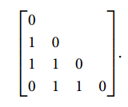
Dissimilarity for attributes of Mixed Type
If f is ordinal: compute the ranks r_{if} and , and treat Z_{if} as numeric.

Slide 15

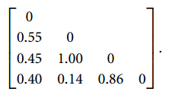
Dissimilarity for attributes of Mixed Type

Slide 16
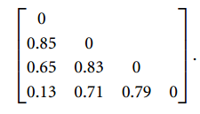
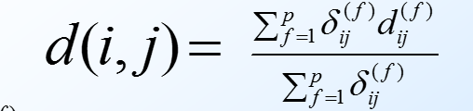

Dissimilarity for attributes of Mixed Type

Slide 17
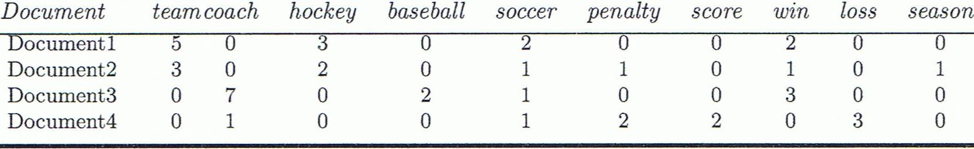
Cosine Similarity
A document can be represented by thousands of attributes, each recording the frequency of a particular word (such as keywords) or phrase in the document.
Other vector objects: gene features in micro-arrays, …
Applications: information retrieval, biologic taxonomy, gene feature mapping, ...
Cosine measure: If d₁ and d₂ are two vectors (e.g., term-frequency vectors), then
cos(d₁, d₂) = (d₁ • d₂) /||d₁|| ||d₂|| ,
where • indicates vector dot product, ||d||: the length of vector d

Slide 18
Example: Cosine Similarity
cos(d₁, d₂) = (d₁ • d₂) /||d₁|| ||d₂|| ,
where • indicates vector dot product, ||d|: the length of vector d
Ex: Find the similarity between documents 1 and 2.
d₁ = (5, 0, 3, 0, 2, 0, 0, 2, 0, 0)
d₂ = (3, 0, 2, 0, 1, 1, 0, 1, 0, 1)
d₁•d₂ = 5*3+0*0+3*2+0*0+2*1+0*1+0*1+2*1+0*0+0*1 = 25
||d₁||= (5*5+0*0+3*3+0*0+2*2+0*0+0*0+2*2+0*0+0*0)^{0.5}=(42)^{0.5} = 6.481
||d₂||= (3*3+0*0+2*2+0*0+1*1+1*1+0*0+1*1+0*0+1*1)^{0.5}=(17)^{0.5} = 4.12
cos(d₁, d₂ ) = 0.94

Slide 19
Edit Distance
The edit distance of two strings is the number of inserts and deletes of characters needed to turn one into the other.
Equivalently, d(x,y) = |x| + |y| -2|LCS(x,y)|.
LCS = longest common subsequence = longest string obtained both by deleting from x and deleting from y.

Slide 20
Example
x = abcde ; y = bcduve. EXAMPLE MAPLE
7 + 5 – 2
LCS(x,y) = bcde.
D(x,y) = |x| + |y| - 2|LCS(x,y)| =
5 + 6 –2*4 = 3.

